Slide 1
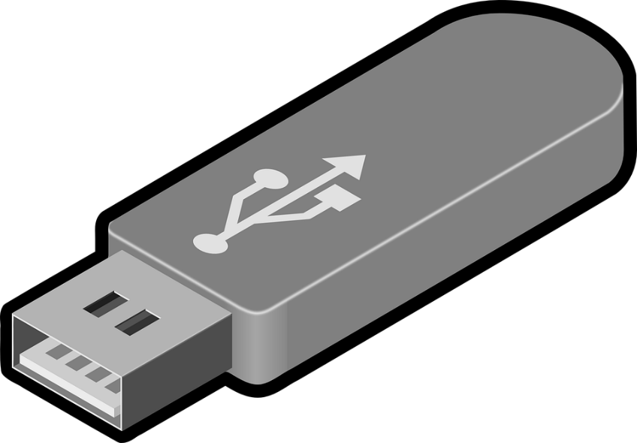
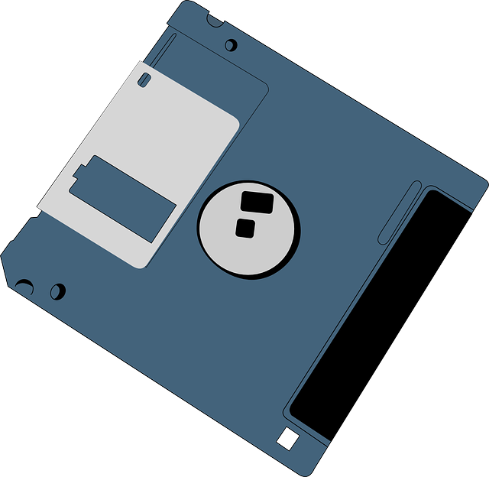
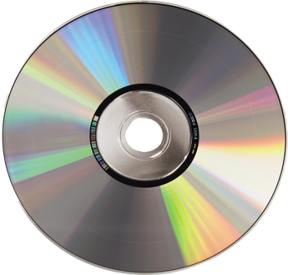
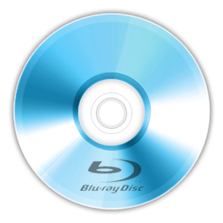
Removable Media
By: Javon

Slide 2
What is it
Removable media is any type of storage device that can be removed from a computer while the system is running. Examples of removable media include CDs, DVDs and Blu-Ray disks, as well as diskettes and USB drives. Removable media makes it easy for a user to move data from one computer to another.

Slide 3
How it works

Slide 4
Types of removable media
Optical discs (Blu-ray discs, DVDs,[1] CDs)
Memory cards (CompactFlash card, Secure Digital card, Memory Stick)
Zip disks/other Floppy disks
Disk packs
Magnetic tapes
Paper data storage (punched cards, punched tapes)

Slide 5
Work cited
http://searchdatabackup.techtarget.com/definition/removable-media

